Slide 1
Xu and Tenenbaum 2007a Replication Summary
23 October 2012

Slide 2
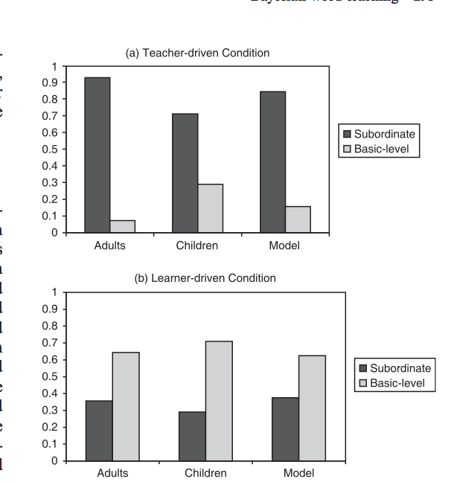
Xu and Tenenbaum 2007a data

Slide 3
Overview
Online Replication 1
Method
Results (N=271)
Online Replication 2
Method
Results (N = 118)
In lab Replication
Method
Results (N = 33)

Slide 4
Online Replication #1
Teacher Method
Learner Method

Slide 5
Notes:
- Generalization pattern:
- proper: no to at least one sub, no to basic
- sub: yes to both sub, no to both basic
- basic: yes to both sub, yes to at least one basic
Bootstrapped 95% CI
297 subjects total (26 thrown out)
22 learners thrown out for not clicking on correct object
2 thrown out for answering check question incorrectly
2 trown out for not answering check question correctly
(8 out of 350 did exp twice, or two experiments)
(45 out of 350 in nolabel condition)

Slide 7
Online Replication #2
Changes to method:
Picture of teacher
Introduce teacher
Add proper trials
Randomize order
Teacher Method
Learner Method

Slide 8
Notes:
150 subjects total (32 thrown out)
22 learners thrown out for not clicking on correct object
5 thrown out for answering check question incorrectly
5 thrown out for not answering check question correctly

Slide 10
In lab script
Thank you for participating in this study. We’re going to play a game that was initially designed for preschoolers, so it may seem a little silly, but just play along. Are you ready to begin?
Training #1
(a) teacher
See this? It’s a ' word_a ’.
See this one? It’s a ' word_a.
See this one? It’s a ' word_a ’.
Thank you for paying attention. Would you like to choose a sticker?
(b) learner
See this? It’s a ' word_a’ .
Can you point to two other ' word_a 's? If you get both of them right you get a sticker!
You’re correct!
You’re correct! Would you like to choose a sticker?
Testing #1
Alright, now I’m going to ask you some questions about ' word_a 's. Are you ready?’
<point to subordinate> Is this a ‘word_a’ ?
<point to nonmatch (check)> Is this a ' word_a’ ?
<point to basic> Is this a ' word_a ?
<point to subordinate> Is this a ' word_a’ ?
<point to basic> Is this a ' word_a’ ?
Alright, now I’m going to show you some new shapes. Are you ready?
<repeat training and testing>
All done! Thank you for participating!

Slide 11
A

Slide 12
B

Slide 13

C

Slide 14

D

